Slide 1
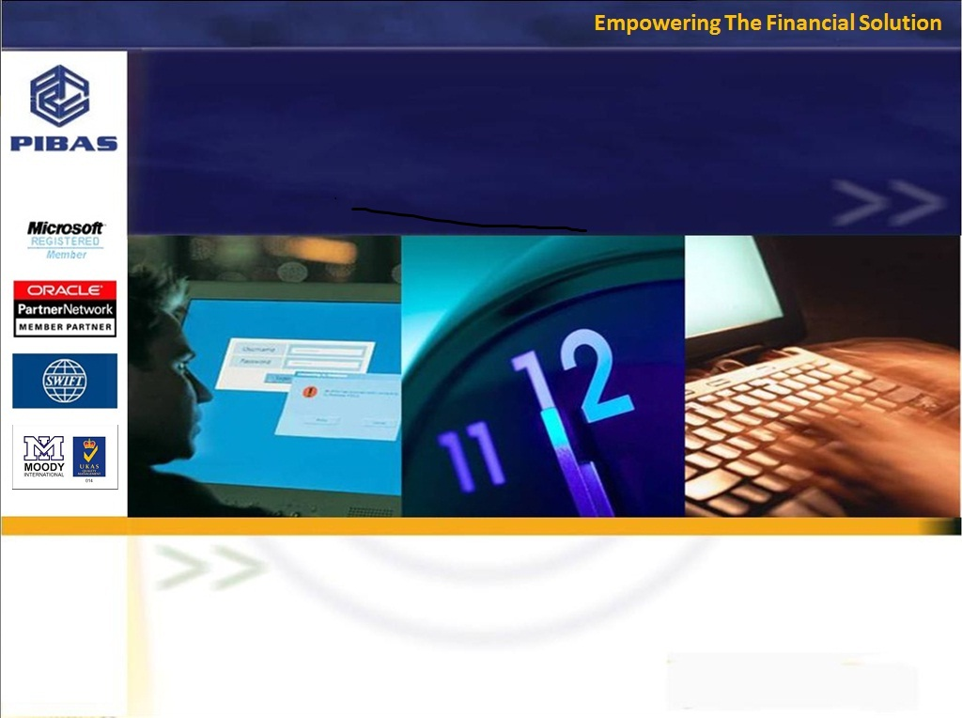
Product Knowledge Training Session PIBAS Products - General Ledger
Presented By Muhammad Asim Senior Support Analyst

Slide 2
Contents
General Ledger
General Ledger Account Maintenance
- Account Opening
- Account Maintenance
- Account Supervision
General Ledger Voucher Maintenance
- Voucher Entry
- Voucher Supervision / Cancellation
General Ledger Inquiries
- Drill Down Facility for Vouchers and Accounts
- Account Inquiry
- Voucher Transaction Review
General Ledger Parameters
- Cost Center Code Maintenance
- Employee Maintenance
- Budget Maintenance
- Parameter Account Maintenance
General Ledger Reports
- Trial Balance Report
- Statement Report
- Statement of Affair Report
- Profit and Loss Report
- Account list (Chart of Accounts Report)
- Voucher Transaction List
- Budgeting – Expense Head Wise….
- Budgeting – Cost Center Budget Month Wise….
- Expense / Income – Cost Center….
- Parameter Accounts Statement
- Voucher Printing / Reprinting
- Day Book Report
- Parameters Report

Slide 3
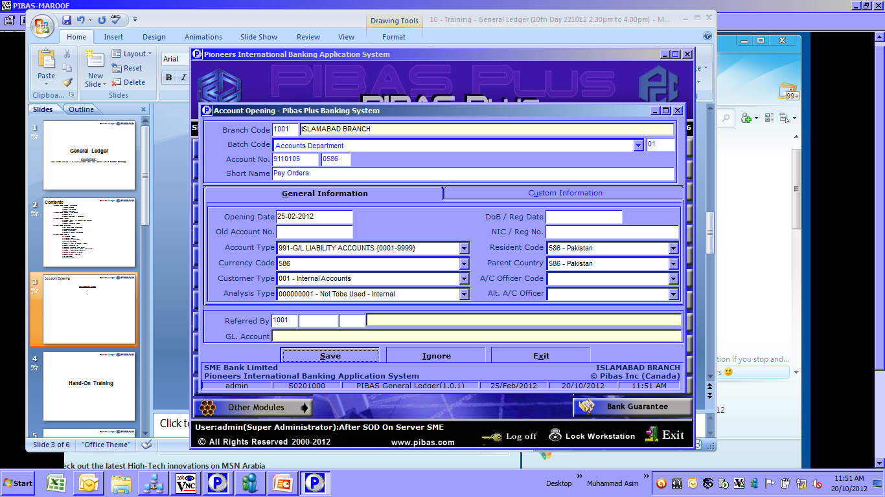
Account Opening
General Ledger
Important Points
Here one can open only GL Accounts as Account Type Field is fixed

Slide 4
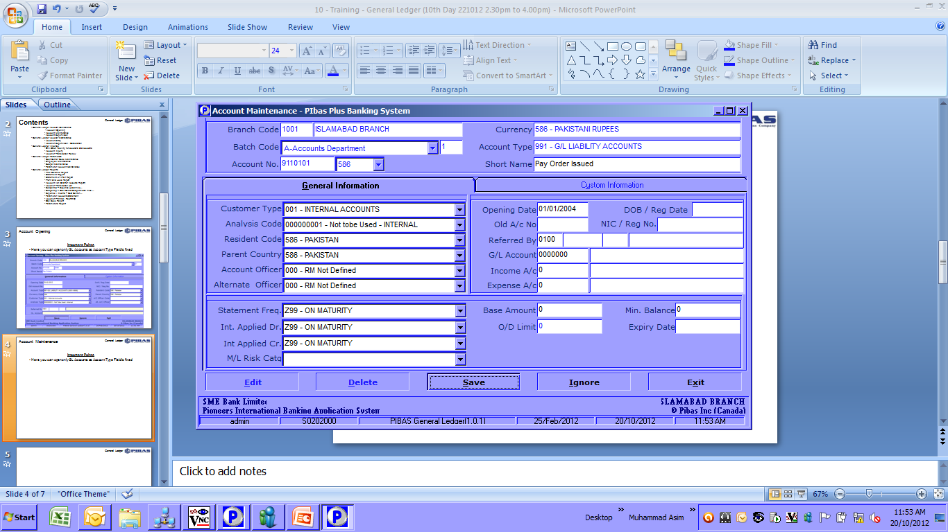
Account Maintenance
General Ledger
Important Points
Here one can amend any opened GL Accounts

Slide 5
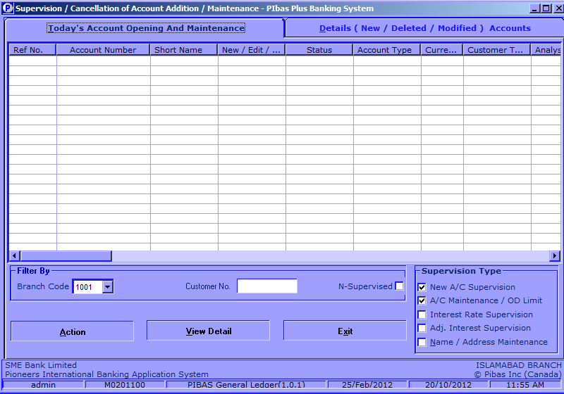
Account Supervision
General Ledger
Important Points
Here one can supervise any newly opened GL account or any amended GL account

Slide 6
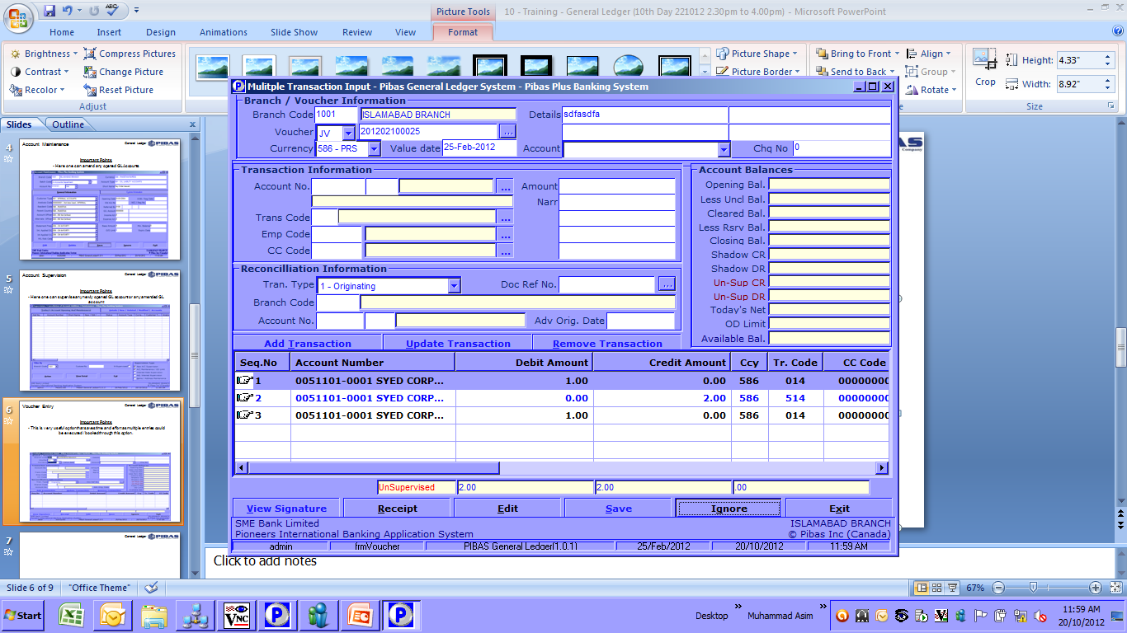
Voucher Entry
General Ledger
Important Points
This is very useful option that saves time and effort as multiple entries could be executed / booked through this option.
Here both GL and Customer Account transactions could be done
While posting of multiple entries you can also note the following difference amount that will appear till the end of balancing of debit and credit
Through this option other vouchers of previous days, can also be viewed.

Slide 7
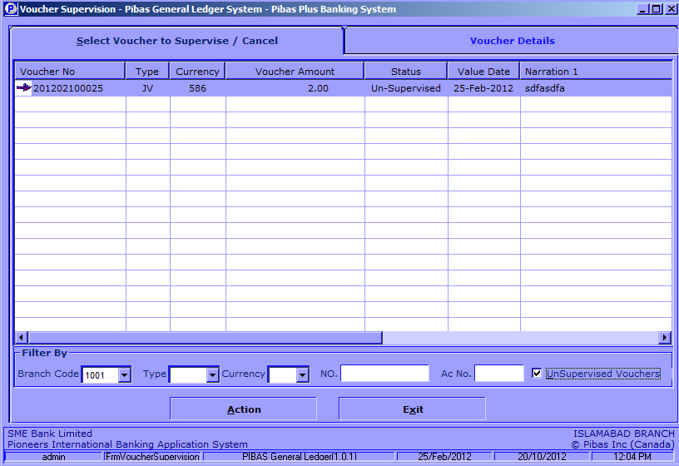
Voucher Supervision
General Ledger
Important Points
Here multiple vouchers are supervised by the authorized users

Slide 8
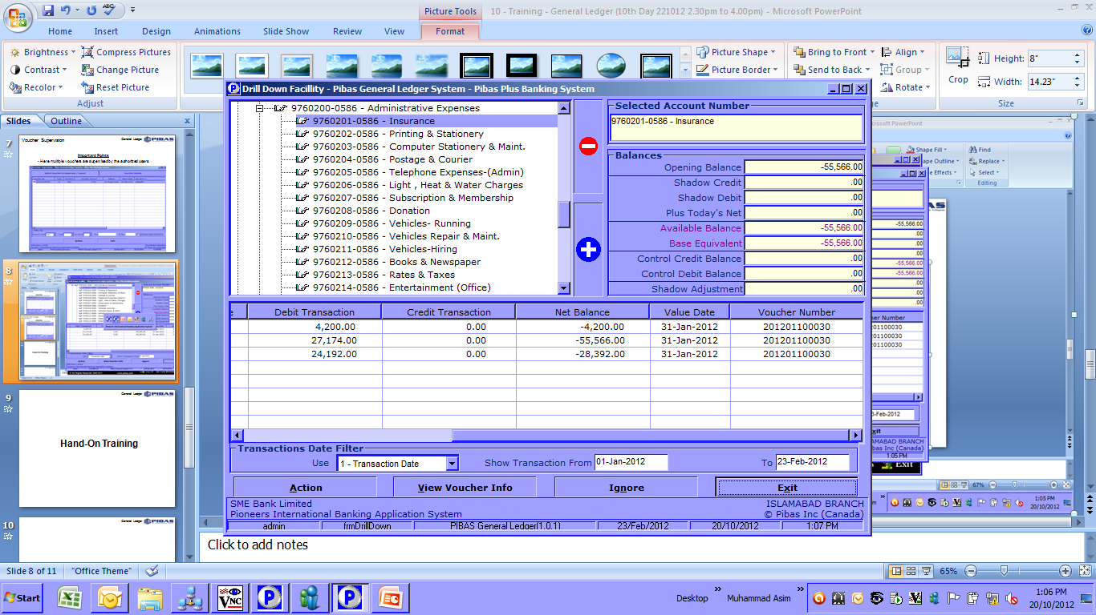
Drill Down Facility for Vouchers and Accounts
General Ledger
Important Points
This facility provides detailed history of voucher, account wise / voucher wise
Here previous vouchers cal also be printed
This option saves time and effort regarding retrieval of voucher on system instead of search for physical vouchers

Slide 9
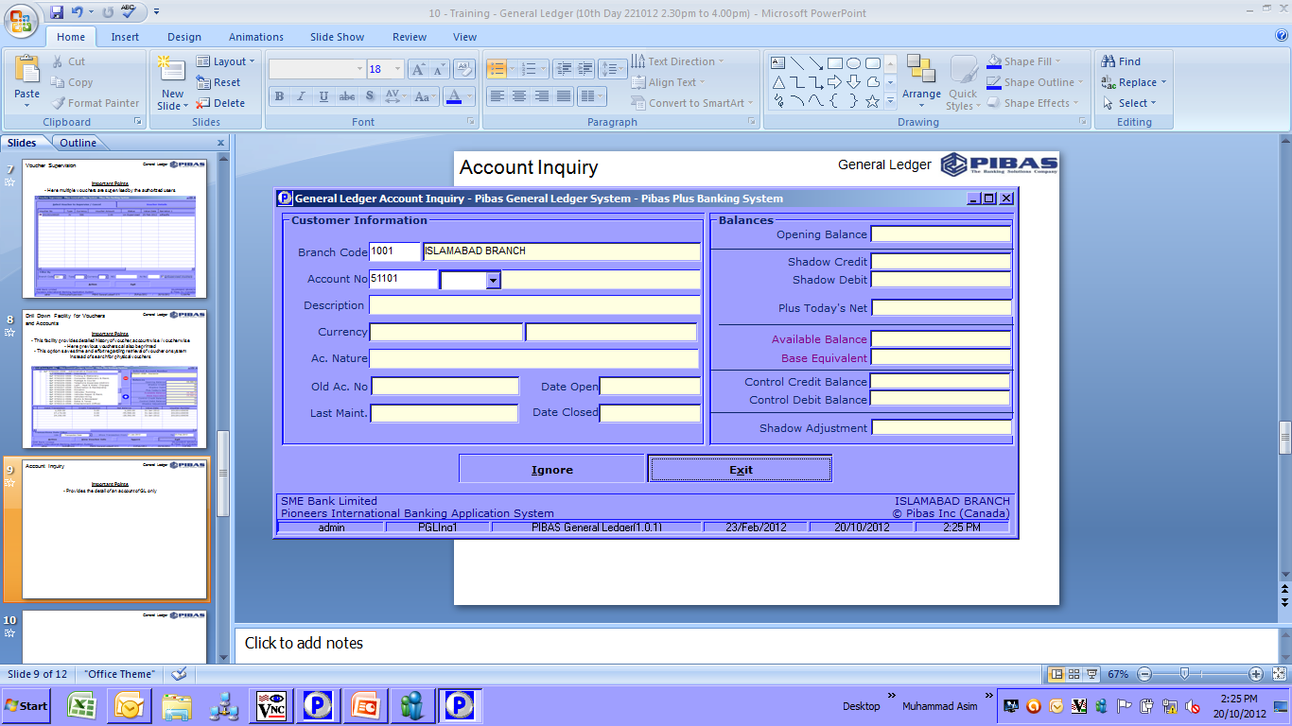
Account Inquiry
General Ledger
Important Points
Provides the detail of an account of GL only

Slide 10
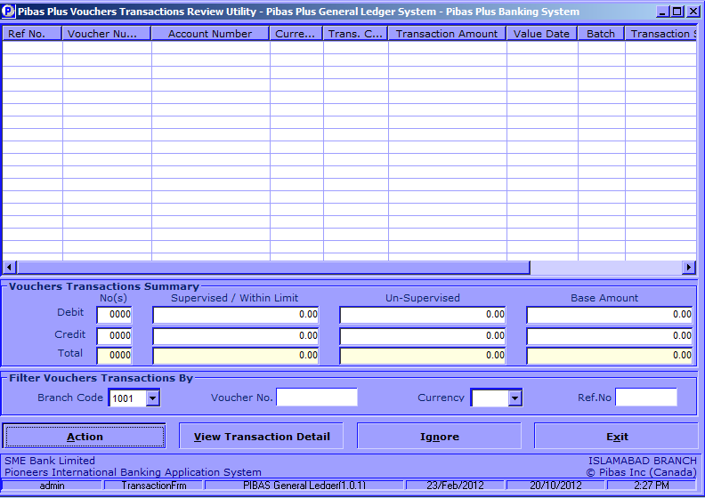
Voucher Transaction Review
General Ledger
Important Points
Provides the detail of voucher posted during the day

Slide 11
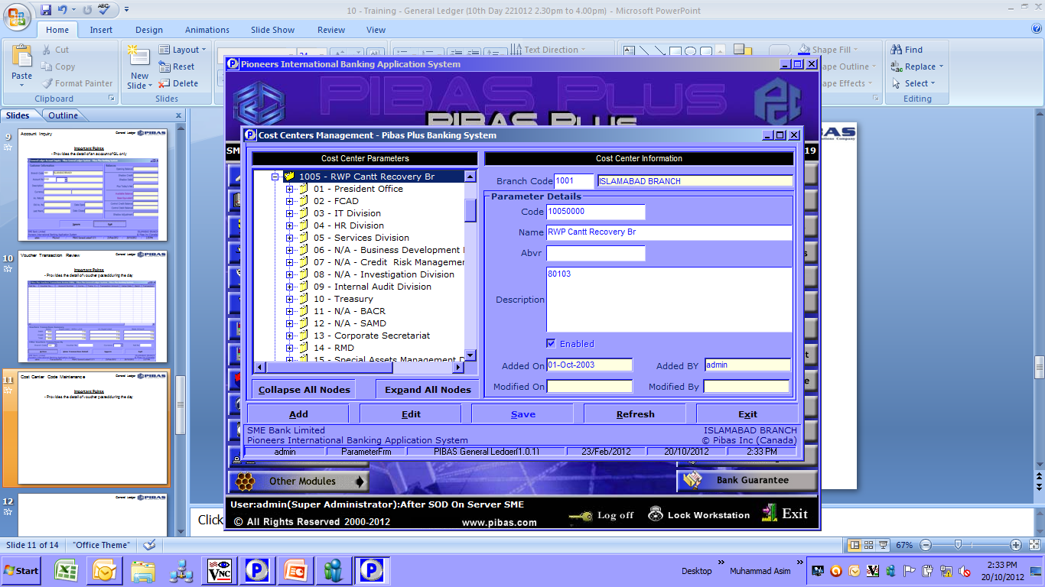
Cost Center Code Maintenance
General Ledger
Important Points
Here Cost Center Parameter are added and changed

Slide 12
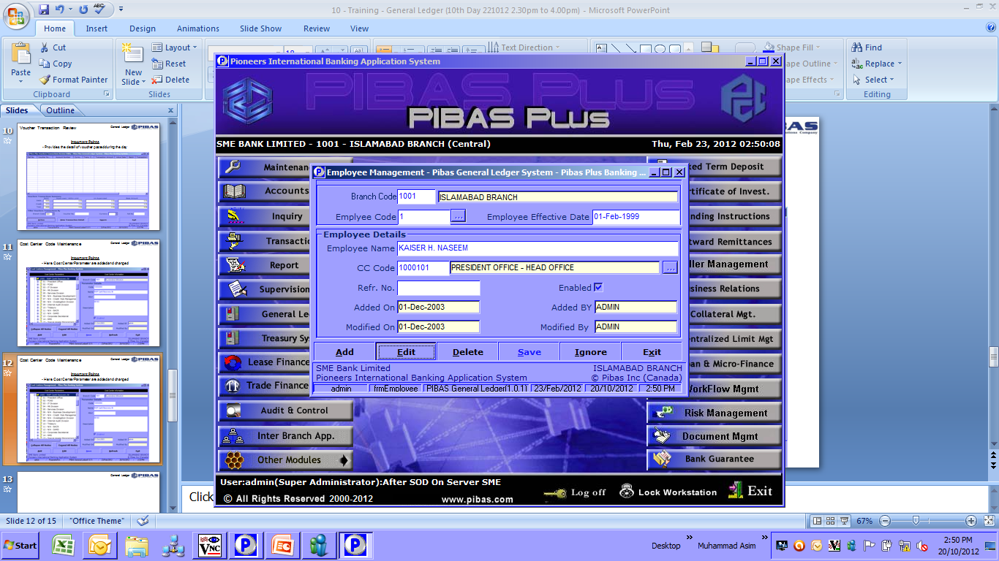
Employee Maintenance
General Ledger
Important Points
Here Employee Parameters are added and changed along with tagging / linking with respective cost center / branch

Slide 13
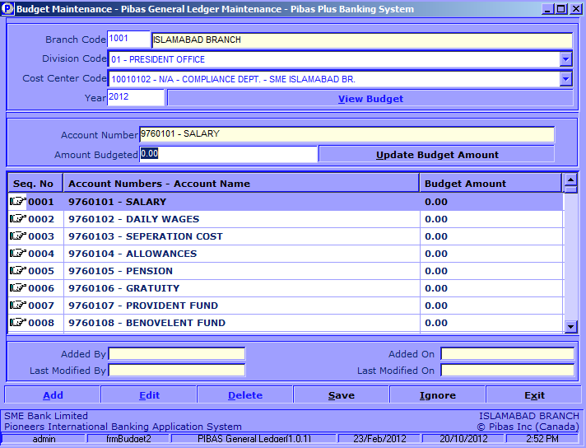
Budget Maintenance
General Ledger
Important Points
Here Budget Amounts are added / changed to analyze budget related reports

Slide 14
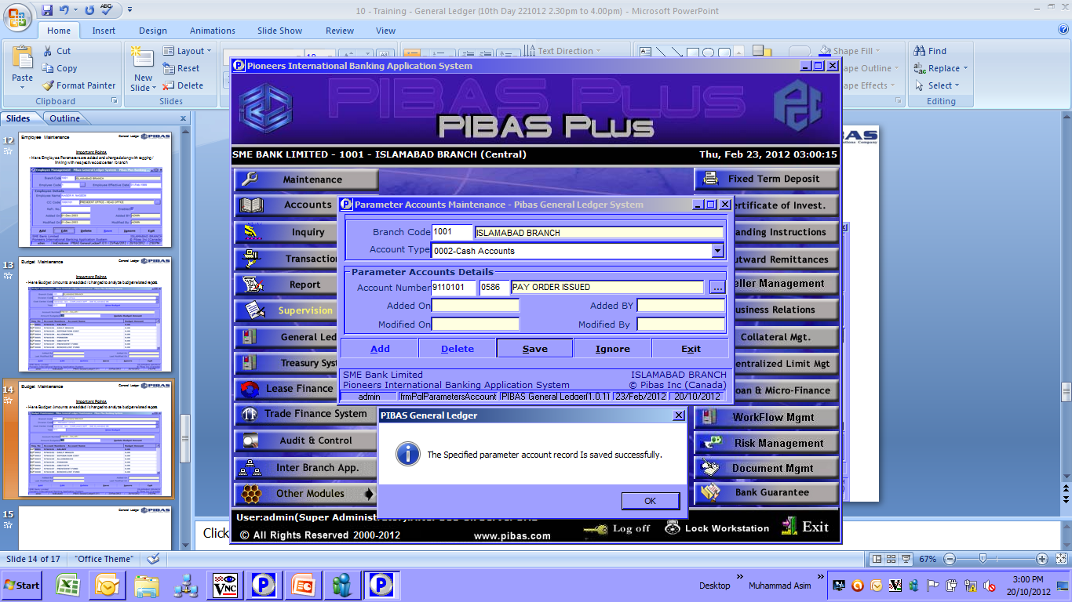
Parameter Account Maintenance
General Ledger
Important Points
Here Account Number Parameters are added / changed

Slide 15
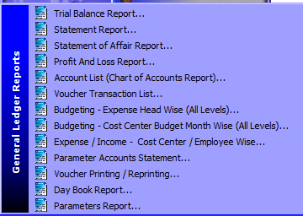
General Ledger Reports
General Ledger
Important Points
Here following important reports are available that we will analyze by generating one by one

Slide 16
General Ledger
Many thanks for your active participation

